Slide 1
Literature Review Slides 3
Dexter Hu

Slide 2
GUI Design Based on Cognitive Psychology: Theoretical, Empirical and Practical Approaches
This was a 2012 experiment to prove the legitimacy of theories related to human memory limitation (HML), perception, and attention by testing them on GUI design, and acquiring feedback from users. The authors concluded that all tested theories were accurate when designing GUIs, and report design-related details to consider.
Draws ideas based on Schema Theory (knowledge is built of blocks), Cognitive Load Theory or CLT (information processing and memory), Retention Theory (amount of memorizable knowledge), Gestalt Law (11 simple design laws) (836).
HML (uses Retention Theory and CLT): limit information to be in 7 +/- 2 chunks (memory capacity) per screen (837).

Slide 3
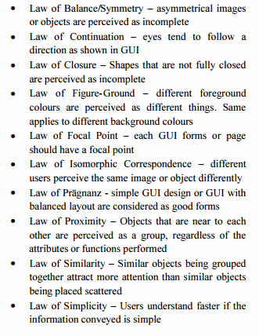

GUI Design Based on Cognitive Psychology: Theoretical, Empirical and Practical Approaches
Perception (uses Schema Theory and Gestalt Law): users will perceive the GUI based on past experiences (“transference”) and the GUI’s looks (“mental imagery”). It should look familiar to them and follow Gestalt Law to accomplish this (837-838).

Slide 4
GUI Design Based on Cognitive Psychology: Theoretical, Empirical and Practical Approaches
Attention: placement of info, motor limitations, and color.
Placement
Start in top-left (least important info can be in bottom-right)
Experiment results disagree: most looked towards center first
Left visual field is used images; right is for text (doing this reduces cognitive load)
Motor Limitations
Avoid having 2+ tasks using motor system simultaneously (e.g. going back and forth between panels while say, editing an object) noting there are sometimes exceptions
Avoid embedded texts/images (e.g. the text + icon combination from Unreal?)
Color
Avoid bright colors due to pupil contraction -- use soft/soothing ones
Avoid combinations like red/green for people who are colorblind
Avoid having both dark and light colors (constant dilation/contraction) (838-839)

Slide 5
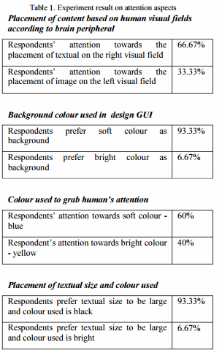
GUI Design Based on Cognitive Psychology: Theoretical, Empirical and Practical Approaches
(839)

Slide 6
Designing the user interface
This was a 1993 report of findings from other literatures. It focuses on general design principles.
The interface should be consistent at semantic, syntactic, and physical levels.
Semantic: The action from each UI element should be consistent with other UIs
Allows users to already know how to use some elements (e.g. adding a new row to a table should be expected if a table has rows)
Syntactic: The terminology in the UI should be consistent
E.g. consistently using either “start” or “play” so the user doesn’t need to know all different types of buttons or commands to do the same function
Physical: One process can always be expected to produce one result
E.g. click an object, click a field on the detail panel, edit it, observe edited object (195)

Slide 7
Designing the user interface
Direct manipulation: simplify commands/processes so that “only simple training” is needed (196).
One example is by allowing graphical objects to be dragged (e.g. drag object into canvas)
Error messages are not necessary if the error was obvious (196)
The UI should contain an updated display of object of interest’s entire status so users can see their actions and if they are “furthering their goals” (196)
Prototyping: requires several iterations
The UI should be designed to minimize the time per action
The UI should allow edits to occur while paused (suspended editing) or running (dynamic editing)
The UI should be separated from the application environment so users don’t need extensive knowledge or programming skills (which is the basis of the game engine project) (196)

Slide 8
Interface design when you don't know how
This was a 1992 report of findings from other literatures. It focuses on the GUI-building process rather than designing the details. While dated, the process it describes adheres to and confirms knowledge from other, more recent literatures.
Set firm deadlines (e.g. 4 weeks to plan, 4 months to build) (30-31)
The iterative cycle is preferred because it supports repeated testing
User testing works well using prototypes followed by a questionnaire, such as the Questionnaire for User Interface Satisfaction (QUIS)
It asks about the screen, terminology/system info, learning, and system capabilities.
It can be modified as needed.
It is recommended because it is not taxing to do and covers the necessary areas, and doesn’t require us to create our own result-recording strategy (31-32)
Set testable usability goals in addition to implementation goals (32)
Hire a graphic designer (not applicable to this project) (30)

Slide 9
Works Cited
Pangalos, George J. "Designing the User Interface." Computers in Industry 22.2 (1993): 193-200. ScienceDirect. Web. 12 Mar. 2016.
Rettig, Marc. "Interface Design When You Don't Know How." Communications of the ACM 35.1 (1992): 29-34. ACM. Web. 11 Mar. 2016.
Yee, Chee Kit, et al. "GUI Design Based on Cognitive Psychology: Theoretical, Empirical and Practical Approaches." Computing Technology and Information Management 2 (2012): 836-41. IEEE. Web. 10 Mar. 2016.

